Slide 1

Prognosis:
Complete remission is a possibility; however, it is limited to milder cases and rates are low. In general, asthmatic patients are much more prone to death from lung diseases, compared to those without. Permanent damage to lung function develops in some patients, most seen in smokers. Patients with unstable (brittle) asthma and those with previous admissions to an ICU are at a high risk for severe complications with their asthma.

Slide 2
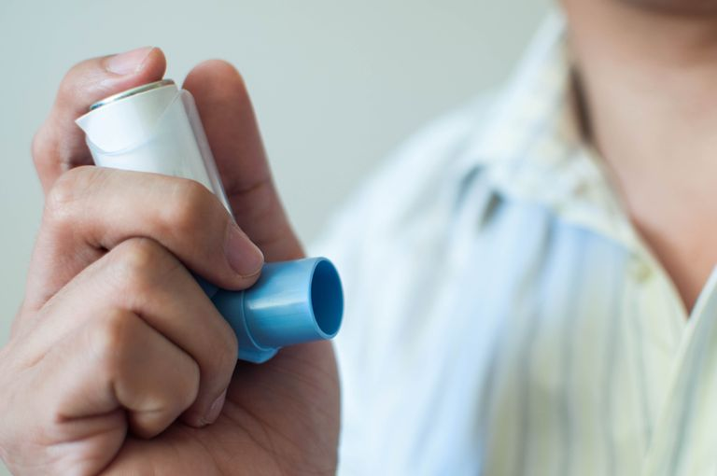
Treatment
Patients with asthma are treated with a regime of daily medicine or long-term control medicines, alongside an inhaler. Treatment for asthma may consist of corticosteroids such as Celestone or Prelone, Biologic medication such as Omalizumab or Mepolizumab, Leukotriene Modifiers such as zafirlukast and montelukast, Mast Cell Stabilizers such as Cromolyn or Nedocromil, and Inhaled long-acting beta2-agonists (LABAs) such as Fluticasone or Budesonide.

Slide 3

Differential Diagnosis
Some of the differential diagnosis for asthma include COPD, Bronchitis, Bronchiectasis, Pulmonary Edema, Pulmonary Embolism, Pneumonia, Hyperventilation Syndrome, Chemical Pneumonitis, and Foreign Body Obstruction.

Slide 4

Actual diagnosis
To understand symptoms and their causes, your doctor will have to review your medical history. This review may include your family history, current medications taken, current physical problems, and overall lifestyle. A physical exam will take a look at your ears, nose, eyes, throat, skin, chest and lungs.

Slide 5
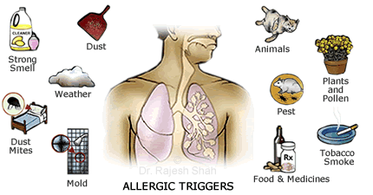
Etiology
The causes of asthma are mainly environmental. Exposure to irritants and allergens can trigger asthma. Airborne substances or pollutants such as to much pollen or cockroach wastes as well as dust mites also cause asthma. Some respiratory infections such as such as cold flue can also result to asthma. Other causes include strong emotions and stress, sulfites and some food preservatives such as beverages and wines preservative gases, and gastroesophageal reflux disease which brings stomach acid back up to the throat. Smoking and strong smell acan also cause asthma.

Slide 6
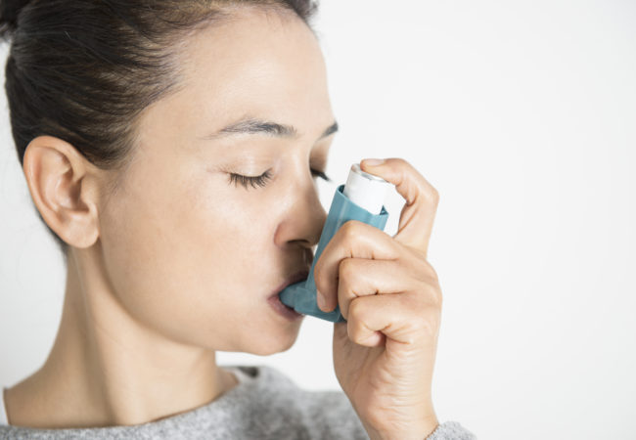
Epidemiology
Asthma mostly affects people who have poor diets and poor lifestyles such as eating fatty food and lacking exercise. The prevalence is more in children than in adults, especially in the United States of America. Recent findings from research on asthma indicates that8.4% of people in the US are asthmatic as compared to the 4.3 % of the people in the whole world. However, these figures are rising. The prevalence is higher in children at 9.5% as compared to the adults at 7.7%

Slide 7
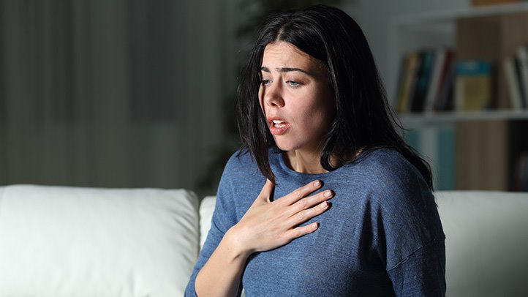
Signs and Symptoms
Symptoms of asthma vary from person to person. Some experience it frequently, or some get signs only at time and some when they are exercising. Generally, the symptoms of asthma include shortness of breath. Difficulty in sleeping due to shortness of breath, tightness and pain in the chest and whistling or wheezing sound when breathing out. Signs of a worsening asthmatic condition include frequent need to use a quick click inhaler and increased difficulty in breathing.

Slide 8
Curable or Non-curable?
Unfortunately, asthma can’t be cured. However, the symptoms can be controlled. Therefore, it is important for one to work with hos or her doctor to adjust the treatment. This is crucial because asthma changes from time to time and the condition is also affected by the weather conditions. One can be vaccinated against influenza and also avoid asthma triggers. Most important, you have to take the medication as prescribed.

Slide 9
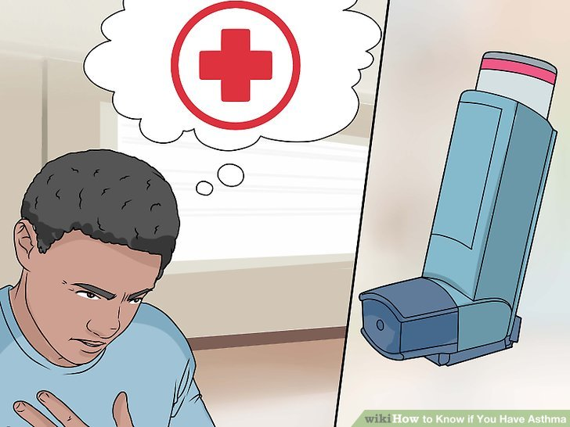
Conclusion
Asthma can be life threatening and therefore, as soon as one experiences the symptoms such as pain and tightness in the chest and difficulty in breathing, he or she should seek medical attention from a doctor. Even though asthma is incurable, one can take precautions and avoid environments with airborne pollutants and strong smells. If found to have asthma, ensure you carry your inhaler all the time and avoid lonely places because you are at risk and might need help anytime. Smoking habits should be shunned as can ;lead to asthma as well as other diseases of the lungs.

